Slide 1



Managing Talent Management:
What’s Up with That?
Trends and Industry Update
Peggy Smith, SCRP, SGMS
Worldwide ERC® President & CEO

Slide 2
Three-Year Goals and Strategies
Goal One
Engage a Larger Percentage of the Worldwide Talent Mobility Community
Increase and expand the worldwide engagement of professionals within corporations whose responsibilities include talent mobility.
Target the engagement of non-traditional relocation-service-provider segments to build their involvement in Worldwide ERC® from a content and financial perspective.
Target the engagement of multi-national corporations and service providers that are headquartered outside of the U.S.
Goal Two
Maximize Member Value
Create a vibrant community of members that fosters engagement, sharing, and innovation.
Effectively address different professional needs of member segments.
Ensure that membership represents the industry’s gold standard for professional credibility and preparation.
Goal Three
Engage a Larger Percentage of the Worldwide Talent Mobility Community
Increase and expand the worldwide engagement of professionals within corporations whose responsibilities include talent mobility.
Target the engagement of non-traditional relocation-service-provider segments to build their involvement in Worldwide ERC® from a content and financial perspective.
Target the engagement of multi-national corporations and service providers that are headquartered outside of the U.S.
Goal Four
Enhance and Expand Brand Awareness, Recognition and Reputation Globally
Refine the brand identity and storyline to best support the global awareness campaign.
Deploy an integrated marketing and communications plan strategy to best leverage ROI across paid, owned and earned media.
Sustain visibility and engagement through a long-term plan of action.
Notes:
http://www.pwc.com/gx/en/ceo-survey/2014/key-findings/transformation/index.jhtml
Changing demographic trends are creating one of the biggest challenges for CEOs today: finding and securing the workforce of tomorrow.
Different population growth rates in different countries – as well as rapid urbanization - are leading to a massive redistribution of the working-age population. And issues like rising labor costs in emerging economies and technological advances - which make it both easier and harder to find skilled workers – are further complicating the picture. Half of CEOs want to hire more people this year, but nearly two-thirds are worried about finding the right skills.
So what are CEOs doing?

Slide 3





Top Global Trends CEOs Say Will Transform Business
Demographic Shifts
Resource Scarcity: Financial
and Talent
Technological
Advances
Urbanization
Shifts in Global Economic Power
Notes:
http://www.pwc.com/gx/en/ceo-survey/2014/key-findings/transformation/index.jhtml
Changing demographic trends are creating one of the biggest challenges for CEOs today: finding and securing the workforce of tomorrow.
Different population growth rates in different countries – as well as rapid urbanization - are leading to a massive redistribution of the working-age population. And issues like rising labor costs in emerging economies and technological advances - which make it both easier and harder to find skilled workers – are further complicating the picture. Half of CEOs want to hire more people this year, but nearly two-thirds are worried about finding the right skills.
So what are CEOs doing?

Slide 4
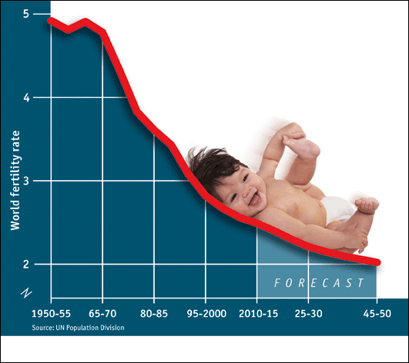
Population Replacement
United States
2.06
Ireland
2.01
Germany
1.42
Ukraine
1.29
Singapore
.79

Slide 5


10K
turn
65
every day
for
19
years

Slide 6

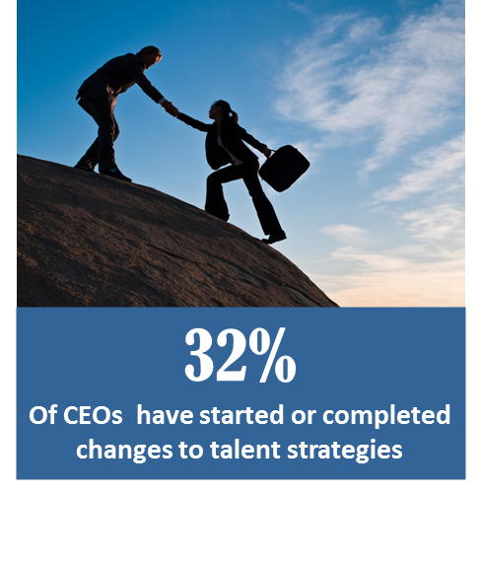
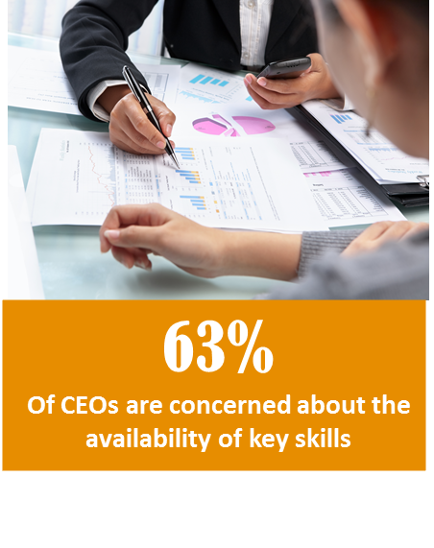
Headcount and Talent Strategies
Source: PWC
Notes:
A full 93% of CEOs knowledge the need to change their talent strategies - though less than a third have acted on their plans. Following the talent to different countries is an obvious solution, but leading companies are also finding better ways to tap into under-utilized sources like the female labor force and older workers, as well as resources outside the employed workforce.
More than 80% of CEOs are planning or making changes to their organizational structure, and they’re also changing how they engage with employees, particularly younger workers. And, while 41% of CEOs think creating a skilled workforce should be a government priority, nearly two-thirds have tasked their own companies to do so.

Slide 7
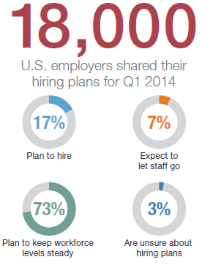
Employer Hiring Plans
Source: Manpower

Slide 8

The Corporate Talent System

Slide 9
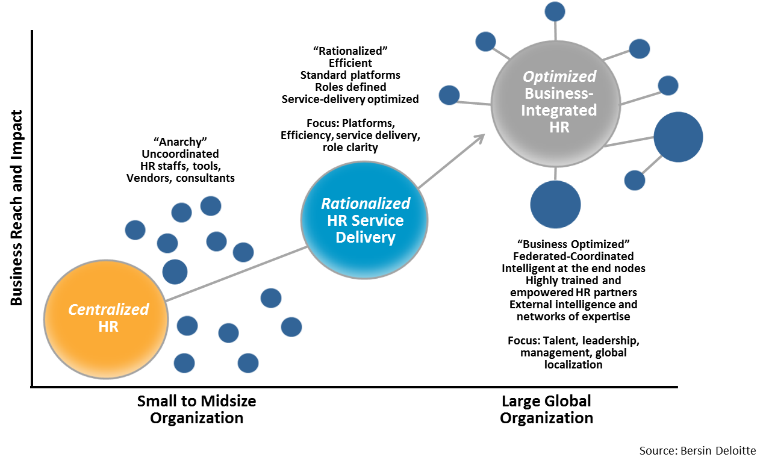
Evolution of High-impact HR

Slide 10
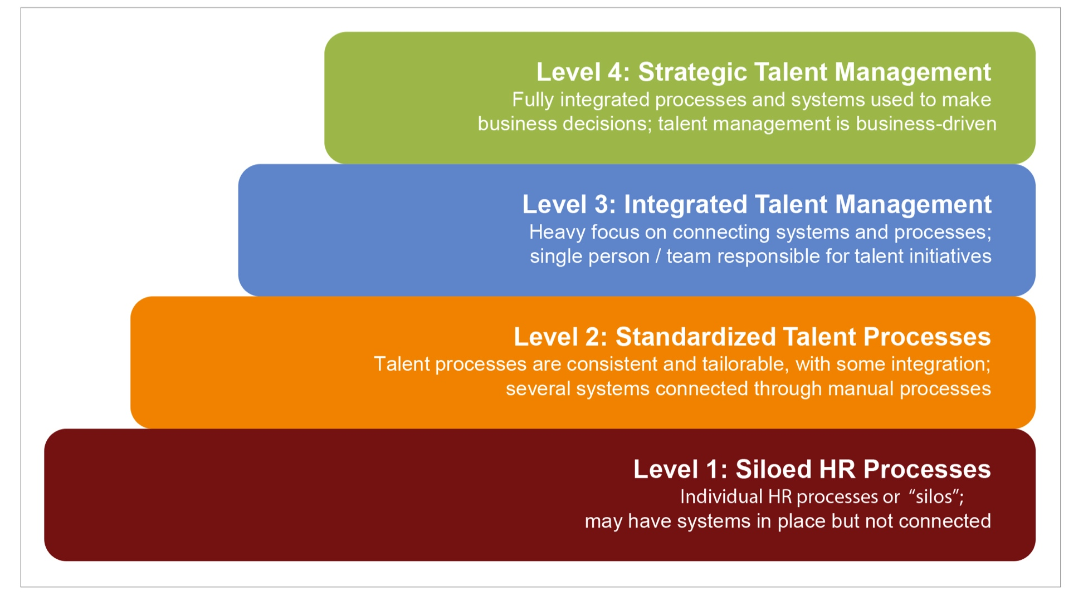
Talent Management Maturity Model
7%
20%
45%
28%
Source: Bersin & Associates

Slide 11

Millenials
&
The MOTYA

Slide 12


Slide 13
Talent Mobility Segmentation
Talent Mobility Segmentation
Primary focus: Corporate-led career pathways and succession management
3
1
Emerging High Potential Talents
Providing international learning and development experiences to grow the next generation of leaders
Strategic Business Leaders
Filling mission-critical roles with high performing and seasoned executives
Low Development Value High
2
4
Career-building Volunteers
(e.g., Gen Y, Millennials)
Facilitating employee-initiated request for international experience to fulfill personal life objectives
Seasoned Technical Experts
Providing technical and specialized resources/expertise to fill local skill gaps or complete a project or task
Primary focus: Business-led career resource planning and deployment
Low Business Value High

Slide 14
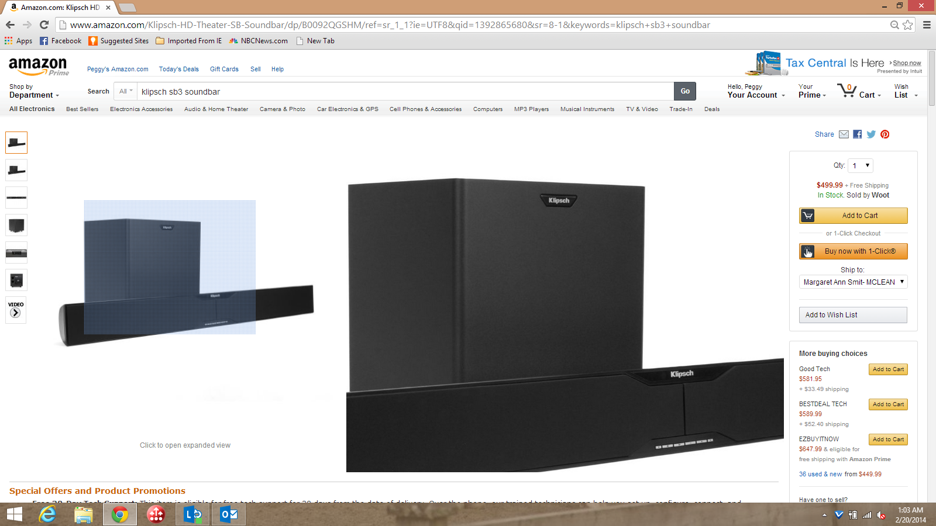
Big Data: Don’t Be Scared!

Slide 15

Join the Conversation
Post your questions or offer tips and advice via eDiscussion Forums
Participate in LearningZone or Corporate HR Peer2Peer free webinars
Notes:
http://www.pwc.com/gx/en/ceo-survey/2014/key-findings/transformation/index.jhtml
Changing demographic trends are creating one of the biggest challenges for CEOs today: finding and securing the workforce of tomorrow.
Different population growth rates in different countries – as well as rapid urbanization - are leading to a massive redistribution of the working-age population. And issues like rising labor costs in emerging economies and technological advances - which make it both easier and harder to find skilled workers – are further complicating the picture. Half of CEOs want to hire more people this year, but nearly two-thirds are worried about finding the right skills.
So what are CEOs doing?

Slide 16


ORLANDO, FL
Complimentary Registration for Corporate HR!
16

Slide 17

17

Slide 18



Slide 19
Talent Management,
Say Hello to Talent Mobility!
Trends and Industry Update
Peggy Smith, SCRP, SGMS
Worldwide ERC® President & CEO

