Slide 1
Around the World in 60 Minutes

Slide 2
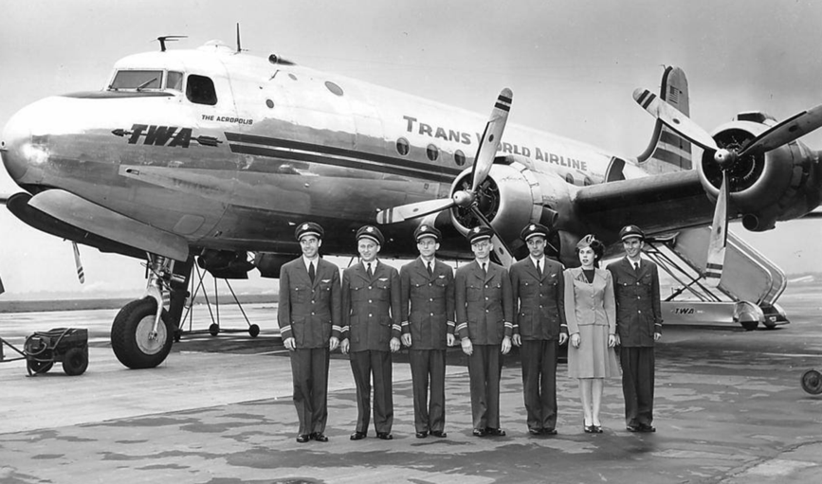
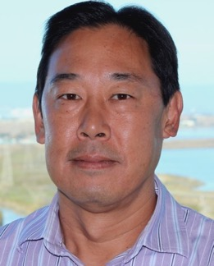
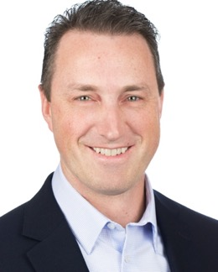
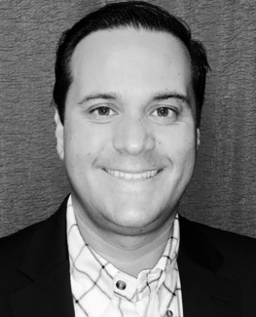
Tour Guides
Paul Onitsuka
Flex
Vice President, Global Mobility
San Jose, CA
Brett Sipes
GTN
Managing Director, GTN Pacific
San Diego, CA
Vini Valverde
Trimble, Inc
Global Mobility Manager
Westminster, CO

Slide 3
Travel Itinerary... Buckle Up!
EMEA
LATAM
APAC
North America

