Slide 1
Mobilizing Superhero Talent
Combining Acquisition, Management, and Mobility to Drive Growth

Slide 2
Introducing our Superhero Panel
15 years of Talent experience across industries
Leads TA, L&D, TM and Diversity
Supports >200,000 employees in 150 sites across 30 countries
Susan Crickenberger
VP Global Talent, Flex
Notes:
Paul to introduce each panelist. Just nod at this point, applause comes hopefully later…

Slide 3
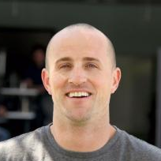
Introducing our Superhero Panel
Scaled Pinterest from 250 to 1,200 employees
3 years as Facebook Director of Recruiting
Led Global University Recruiting and Recruiting Operations
400 technical and 900 intern hires per year
Adam Ward
Head of Recruiting,
Pinterest
Notes:
Paul to introduce each panelist. Just nod at this point, applause comes hopefully later…

Slide 4
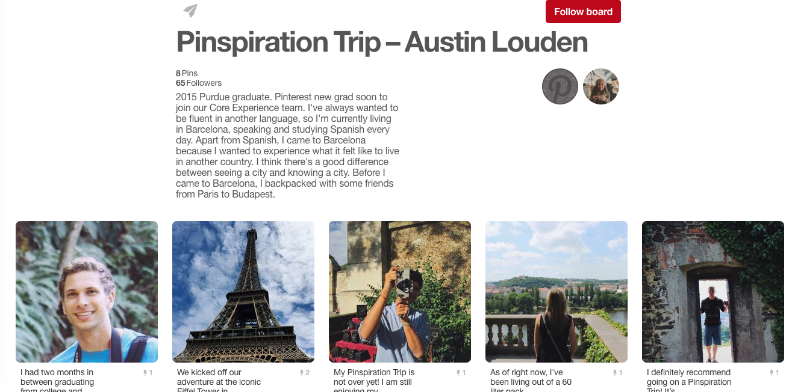
Pinspiration
Notes:
Pinspiration Trip - differentiator
1200 employees
7 countries
125 relos, 90% domestic
Relo Program essentially has 2 policies:
New Grads
New Hires (includes domestic + international)
Designed for simplicity and flexibility
Core services, but allows the employee to customize the benefits, while still offering uniform benefits to all.
o Flexibility. As long as EE doesn’t exceed budget, can use household goods move for almost anything. Tailors the benefits provided to each employee’s unique relocation scenario.
o New Grad program: to select the benefit that they wish to receive allows them to customize their relocation package depending on the services that they feel would be most beneficial.
o Direct bill: each of the core benefits (with the exception of final move mileage, should the employee elect to drive). This allows for a smooth transition for each employee and eliminates the burden of paying for expenses out of pocket and submitting for reimbursement. This allows employees to better focus on their new job responsibilities, settling in to their destination location, locating housing, etc. without the added financial stress that can come along with a relocation.

Slide 5
Introducing our Superhero Panel
Led the creation of global mobility at Nike
Recently joined Talent Mobility COE
Focused on strategic deployment of talent and optimizing Nike’s human capital investment
15 years of experience in a variety of HR disciplines
Michael Mathis
Talent Mobility Director, Nike
Notes:
Paul to introduce each panelist. Mike provide a short comment on the size of Nike and #’s of countries with operations.

Slide 6
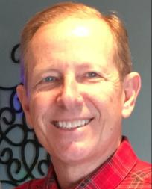
Introducing our Superhero Panel
Leads global mobility
Handles immigration, relocation, and individual tax policies/processes
Manages the Senior Executive program providing relocation, home sale, and home purchase programs for executives
Eric Halverson
Director of HR Global Mobility, eBay
Notes:
Paul to introduce each panelist. Eric provide a short comment on the size of eBay and # of countries of operation

Slide 7
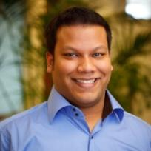
Introducing our Superhero Panel
Helps set people strategies using analytics
Takes a holistic, data-driven look at interaction of careers, rewards, and employee preferences
Worked at Mercer San Francisco, Los Angeles, Dubai, Melbourne and Houston
Specializes in technically focused organizations
Tauseef Rahman Talent Principal, Mercer
Notes:
Paul to introduce each panelist. Just nod at this point, applause comes hopefully later…

Slide 8
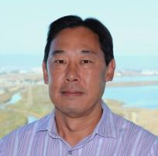
Introducing our Superhero Panel
Leads Global Mobility and Stock Plan
Manages 500 expatriate/local plus employees, 300 domestic relocations, 400 immigration cases
Uses Analytics and Talent synergies with mobility to attract, motivate and retain key talent
Paul Onitsuka
VP Global Mobility, Flex
Notes:
Paul to briefly bring attention to Flex’s program #’s

Slide 9
Flex then
Talent Acquisition
Global
Mobility
Talent Management
Total
Rewards
Notes:
Specific programs e.g., mobility for leadership development, transfers in place of local hires?
Eric – comments on eBay’s growth over the many years you’ve been their Superhero?
Susan – strategic talent mapping being done at Flex? What areas did Flex start looking at?

Slide 10
Employees say
I want more Training
and Development!
Help me plan
my Career!
Give me Feedback!
What
about
me?
Does the best person really get the promotion or opportunity?
Notes:
This slide shows common thoughts and requests by employees…

Slide 11
Managers say
No one is ready…
I have to hire externally!
Help me talk
about my
employees careers!
Who has the skills I need?
Help
me!
Plan better development experiences
Notes:
And this slide shows common thoughts by managers…

Slide 12
Combining talent acquisition, talent management, and mobility
How does your company combine talent acquisition, talent management, and mobility program to support organic growth?
Notes:
Panel exchange -

Slide 13
Connecting across functions
What has helped you integrate across functions?
Are there specific programs which go well?
Notes:
Specific programs e.g., mobility for leadership development, transfers in place of local hires? Panel exchange

Slide 14
Using analytics to drive change
To what extent do you track things like
How have you started to overcome challenges to tracking this information?
 | PERFORMANCE |  | PROMOTION |  | TURNOVER
JOB | MOBILE | LOCAL | MOBILE | LOCAL | MOBILE | LOCAL
SOFTWARE DEV | 3.00 | 3.75 | 3% | 3% | 4% | 6%
PRODUCT MANAGER | 4.25 | 3.50 | 0% | 5% | 2% | 2%
VP BUS DEV | 3.25 | 3.25 | 4% | 2% | 5% | 2%
Notes:
Panel exchange on how data is integrated in people processes at each of their co’s?

Slide 15
Flex now
Talent Management
Global Mobility
Talent Acquisition
Total Rewards
Notes:
Susan and Paul provide comments on Flex’s evolution

Slide 16
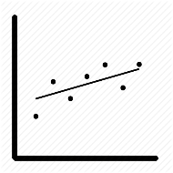
Flex now
Talent Pools
Talent Reviews
Performance Framework
Global Mobility
Development
Planning
Diversity
Rotational Programs
Build vs Buy
Promotions & Movement
Performance Trending
Notes:
Susan briefly speaks to the increasing TM efforts across Flex…
Panel – Build vs Buy at your co’s? Rotational programs? How established? Top down sponsorship?

Slide 17
Nike: Talent mobility strategy
BUSINESS DRIVERS
Talent development
Talent deployment
GOAL
Build enterprise leader
Top talent -
Next gen talent
Capability deployment
Knowledge transfer
EXAMPLES
Fill top or key position
Activate succession or career plan
Build employee enterprise leadership capability
Provide critical career development experience
Accelerate development of critical talent
Provide expertise to address a local gap
Acquire top talent or key capability
Fill mission critical role
Protect intellectual property
Develop / train successor in local country
Develop local expertise or capability
TARGET
TALENT PROFILE
PromotableS & E7
Top Talent
E & S
Promotable U
& above
Promotable U
& above
High Potential U (Territories)
High Performing & At Potential U & above
Notes:
Mike briefly explains Nike’s mobility strategy. Lead to short compare and contrast comments by other panelists;

Slide 18
Questions and Answers
What questions do you have for the panel?

