Slide 1
New Avenues for Stakeholder Communications
From the C-Suite to the Global Employee

Slide 2
Sameer
Khedekar
Yuki
Watanabe
Ariella
Zwerling
Julie
Pearl

Slide 3
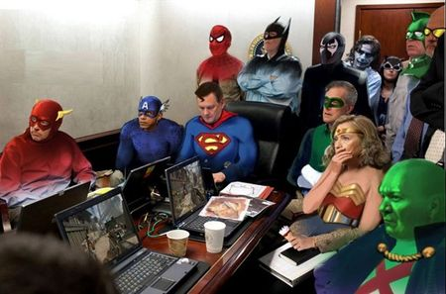
What is a “seat at the table”?
Why does it matter?
Visibility
C-level buy-in
Reassurance that the program is taken care of
Support when it’s needed
Emergency communications
(Doesn’t necessarily mean being at all the meetings!)

Slide 4
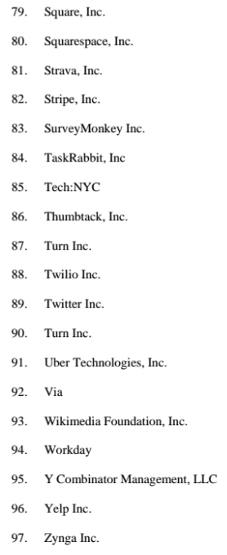
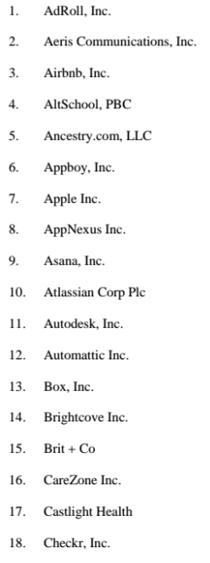
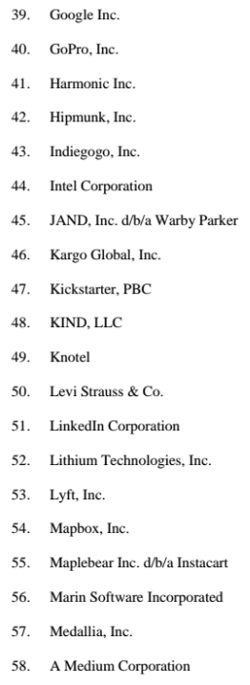
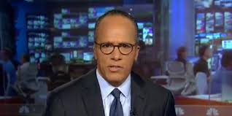

Slide 5
Leading American Retail company with 16B Net Sales* and 140,000 employees, 3700 stores (owned + Franchise), 70+ countries worldwide
Office in Canada, UK, France, Mexico, Japan, China, HK, India, Vietnam
Centralized Mobility Program Management based in SF (one stop shop)
300 domestic relocation : SF / NY, lump sum to full relocation
50 – 200 cross border relocations
Long / short term, perm. transfer, hybrid
Top host location: China, HK, Vietnam, US
* FYE Jan. 2016

Slide 6
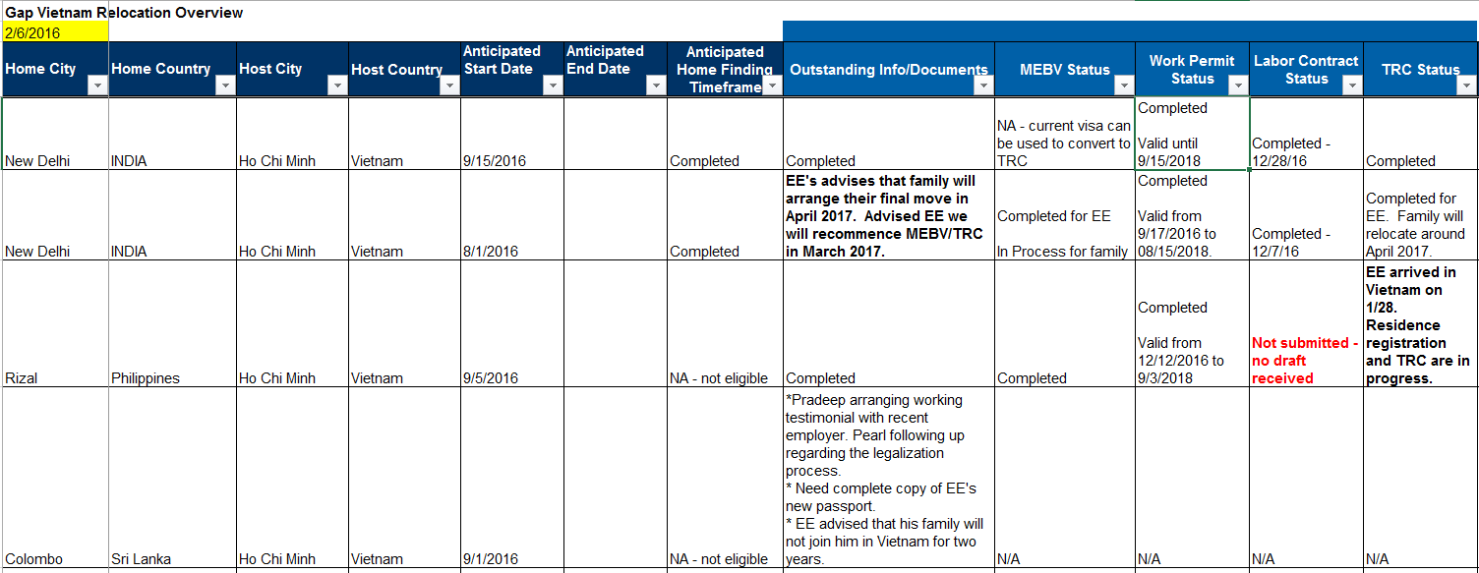
Project Study: VIETNAM

Slide 7
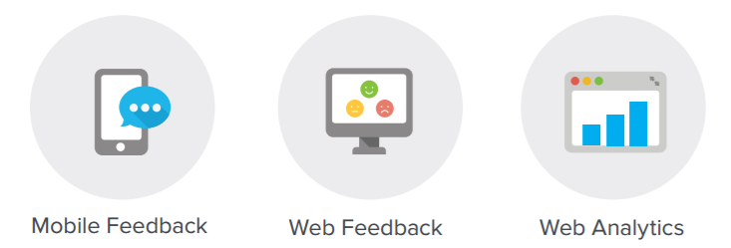
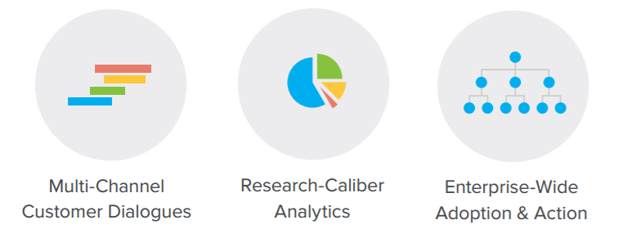
Leading customer experience management company – helping businesses solicit and analyze feedback in real time
Growth from 300 → 1,000 employees in 3 years
Offices in Palo Alto, NYC, Buenos Aires, London, Paris, Germany and Australia
Core Global Mobility Team in Palo Alto with partners in EMEA and APAC

Slide 8
The Empathy Lens
Quality & Empathy can outshine Efficiency & Technology
Offer Accepted
Relocation Initiated
In Transit
Arrival
Moments
that matter
Excited
Motivated
Inspired
Positive
Engaged
Knows expectations
Educated
Calm
Trusting
Owner in the process
Prepared
Excited
Organized
Confident
Ready to continue the journey
We want
Medallians
to feel...

Slide 9
What Does Your CEO/CFO/CHRO/GC Need to Know?
Urgent
Ongoing

Slide 10
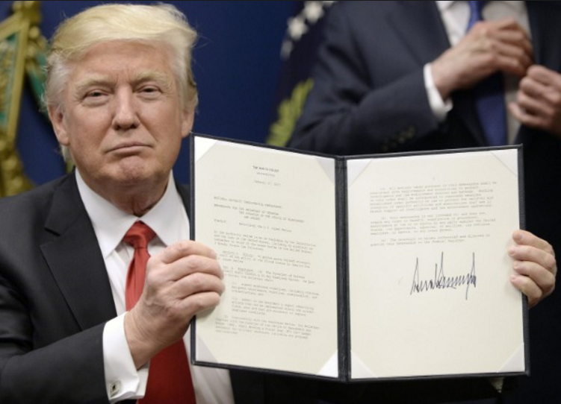
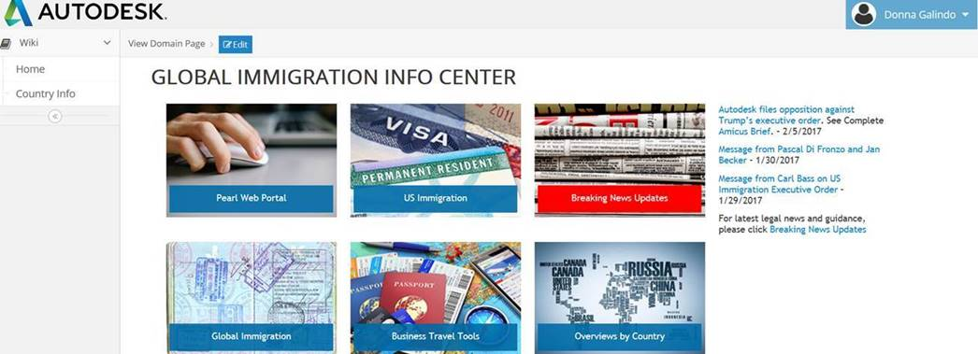
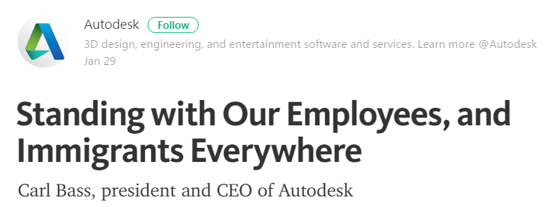
Travel Ban Response

Slide 11
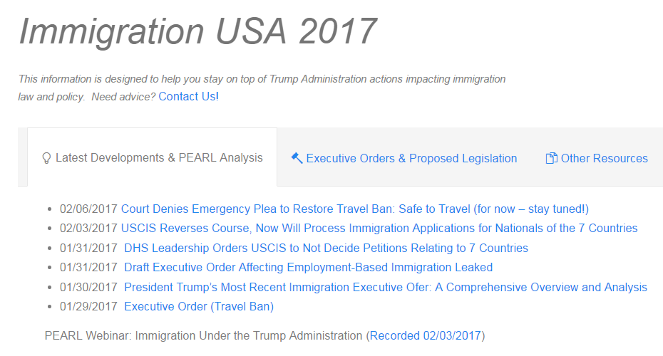
Travel Ban Response (continued)

Slide 12
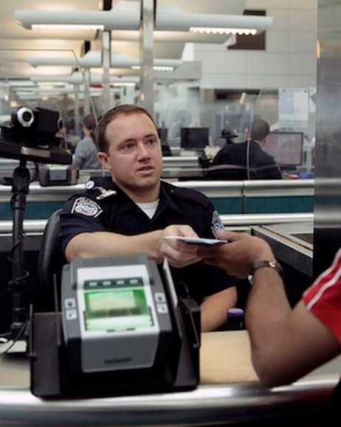
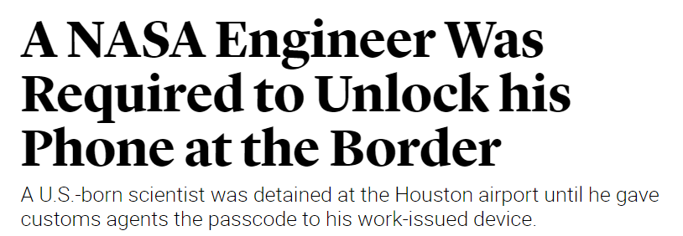
Travel Policies and Security Issues

Slide 13
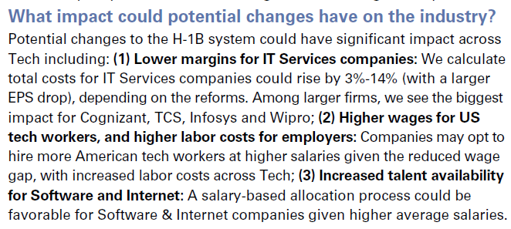
Potential H-1B Program Changes
Higher wages for US tech workers
Lower margins, higher costs for IT companies
Increased talent availability
Highest impact: Indian IT workers

Slide 14
Potential OPT and H-4 EAD Reversals

Slide 15
Canada to the Rescue?

Slide 16
Executive Briefings
Urgent:
Requires Decision Making or Action
Ongoing:
Improvements
Resources
Policy Changes/Updates
Protocols

Slide 17
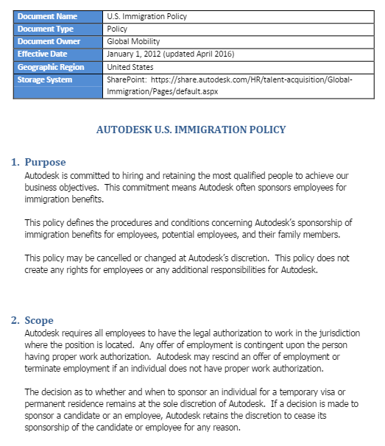
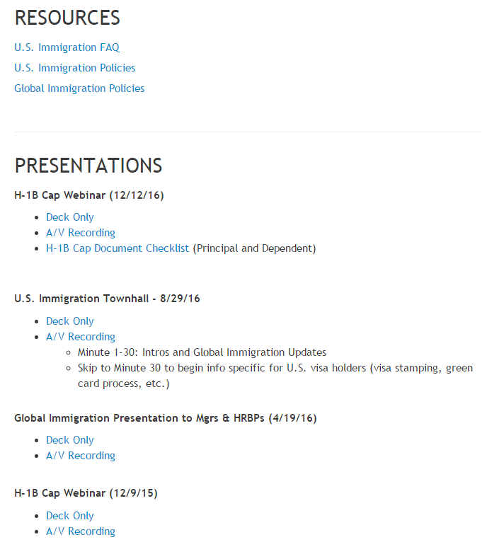
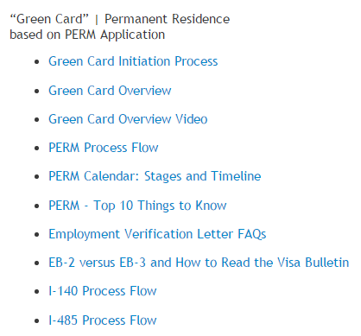
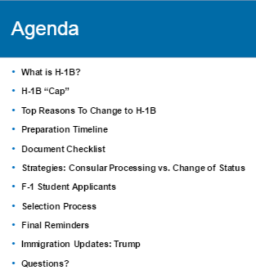
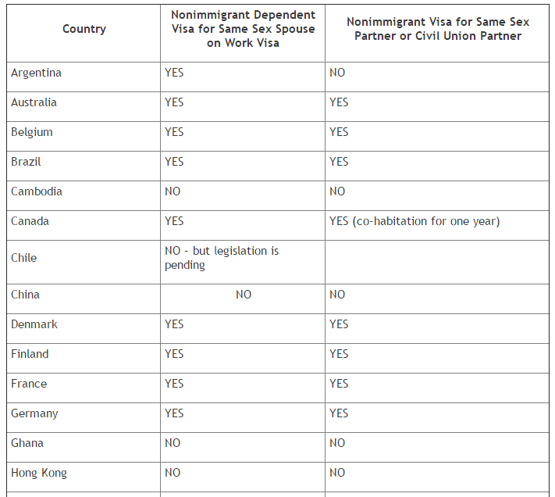
Resources

Slide 18
WHAT’S ON YOUR WISH LIST?

