Slide 1
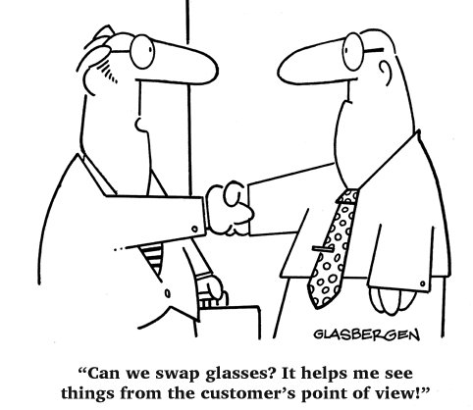

Slide 2
Understand YOUR Scope of Services
Clearly define what services you are going to expect the relocation company to manage
Look to your policies for guidance
Build an internal cross functional team to understand what questions you really need to ask and customize

Slide 3
Learn About the Marketplace
Who is out there and how do they position themselves
Business strategy of a potential suppliers
Financial Stability
Global coverage

Slide 4
Build YOUR RFP
Pair down the questions to as few as possible to get to the heart of the information you need
Make sure your scoring reflects the areas that are most critical to you
Ensure that questions are clear and provide enough detail to get concise answer back

Slide 5
This includes a lot of areas you may not initially think of such as:
Service model you expect
Team configuration and experience
Integration with current suppliers
Integration with technology
What type of funding you expect
Technology/Reporting requirements
Contractual requirements

Slide 6
Have Your Facts Ready!
Volume information
# Homeowners
GBO, BVO, Direct Reimbursement, Unsupported
# Renters
# Short-term Assignments
# Lump sums
# Candidate/Intern
# International moves
# of Long-term assignments
# of Short-term assignments
# of Employees currently on-assignment
# of Employees expected to be on-assignment receiving support

Slide 7
Have Your Facts Ready!
Current average home sale/purchase value
Average duration of assignments
Currently policies or proposed policies
How you want to fund your program?
Will billing be centralized? If not how many locations will be billed?
Any existing contract with suppliers that vendor is required to utilize?

Slide 8
Getting an RFP Right Doesn’t Have to be Hard
Do’s
Get various sample RFPs to create YOUR OWN RFP from
Pre-select invitees to limit confusion and overlap
Carefully construct your pricing sheet and questions
Ensure that your scope is clearly defined
Include your policies with the RFP
Ask very specific questions about your program/your pain points/your scope

Slide 9
Getting an RFP Right Doesn’t Have to be Hard
Don’t
Take a generic RFP and just send it out. Cull it down to what you are REALLY interested in. More questions will not necessarily make your decision easier
Don’t ask me to “explain my entire process for “X”” and then only give me 250 words to do it in
Ask the same question six different ways – it confuses us
Use a generic pricing sheet, use one that is tailored to your need
Limit the Q&A period or only have one chance to submit

